Slide 1
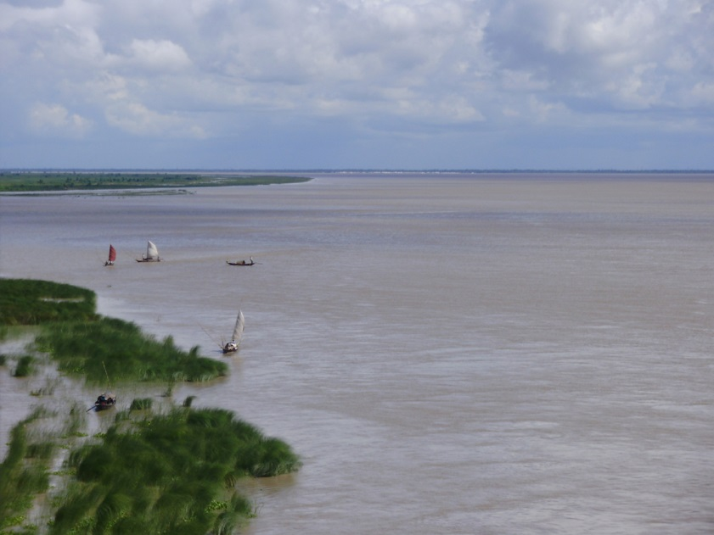
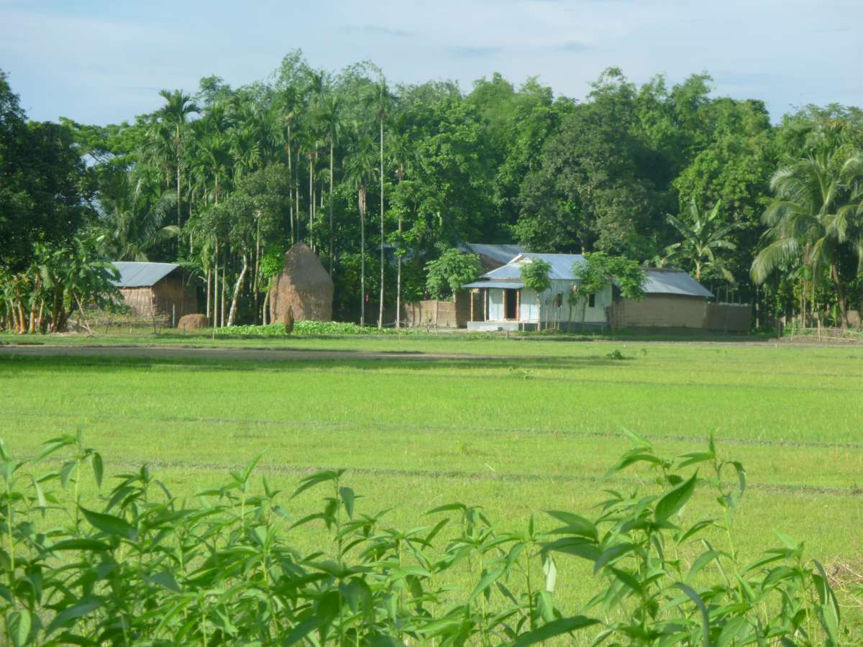
W
E
L
C
O
M
E

Slide 2
Note for the honourable teachers:
The subject teachers are requested to read the notes given below the slides.
Notes are given bellow the slide no. 9, 14, 16, 17 and 18.

Slide 3
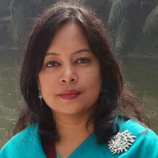
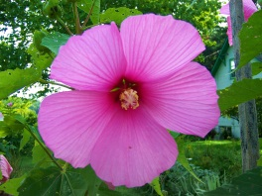
INTRODUCTION
ROUFUN NAHAR
ASSISTANT TEACHER ( ENGLISH)
MAZIDA GOVT. HIGH SCHOOL,
TONGI, GAZIPUR
CLASS: NINE-TEN
SUBJECT: ENGLISH 1ST PAPER

Slide 4
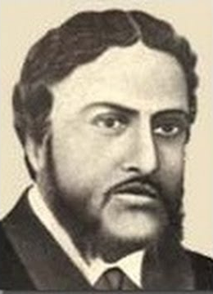
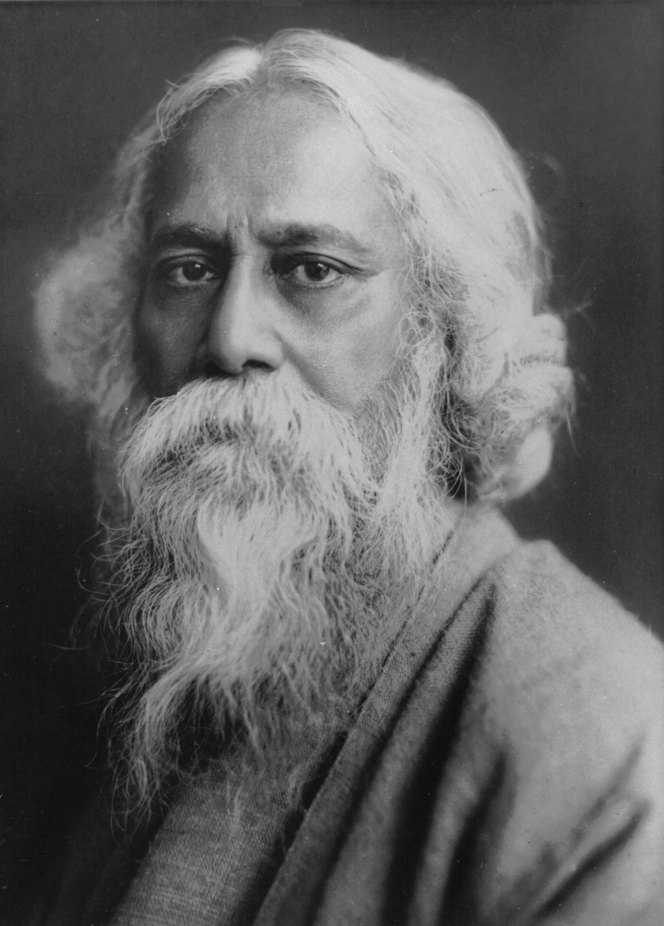
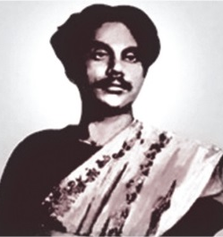
Who is the sonnet writer out of them?
Michael Madhusudan Dutt

Slide 5
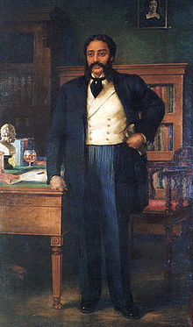
took education from Europe
Some information about Michael Madhusudan Dutt
felt for his motherland and returned home
wanted to be like an Englishman
not appreciated for his deeds
wrote many English poems and dramas

Slide 6
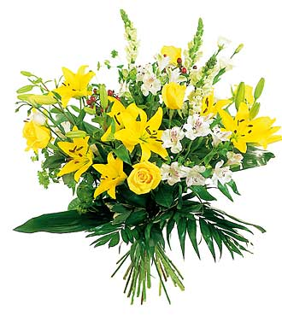
Today our topic is
The return of the native
Unit- 12
Lesson- 3

Slide 7
Learning Outcomes Of The Lesson
After this lesson the students will be able to-
1. talk about the pictures.
2. listen for specific information.
3. read and a text and find out information.
4. make WH questions.
5. infer the word meaning from the text.

Slide 8
Listen to the audio about Michael Mahusudan Dutt and choose the best answer.
1. Michael Madhusudan Dutt’ father was a _______ .
a) doctor b) teacher c) business man d) lawyer
$$$$
2. He was a pioneer of __________ .
a) Bengali poem b) Bengali drama
c) Bengali novel d) English drama
$$$$
3. His famous work ‘Meghnad Bodh’ is a _____ .
$$$$
a) tragic epic b) comic epic
c) tragic drama d) comic drama
4. He also wrote poems about __________ .
a) the sorrows and joys of love
b) the sorrows and affluences of love
c) the sorrows and afflictions of love
$$$$

Slide 9
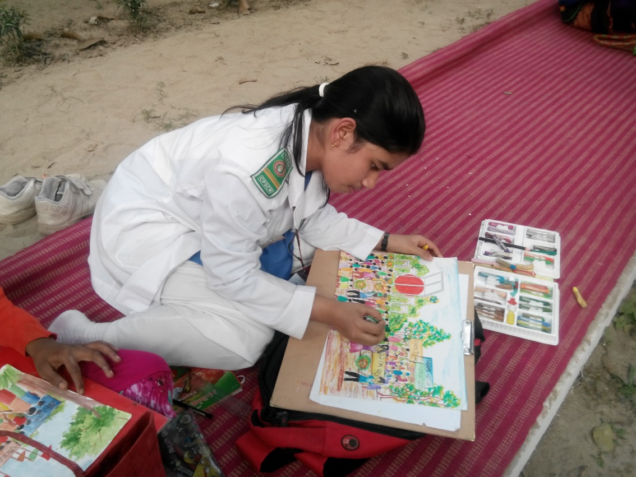
Aspire
hope for/dream of/long for/wish for/desire/want
Meaning
She aspired to be a great artist in future.
Notes:
First, the word will be shown. The SS will be asked to pronounce the word. If it is needed teacher can help. Then the picture and the sentence will be shown and asked to guess the meaning. After that the meaning will be shown. Then the teacher can ask the students to make a sentence of their own. In the same way, slide no. 8-12 can be conducted.

Slide 10
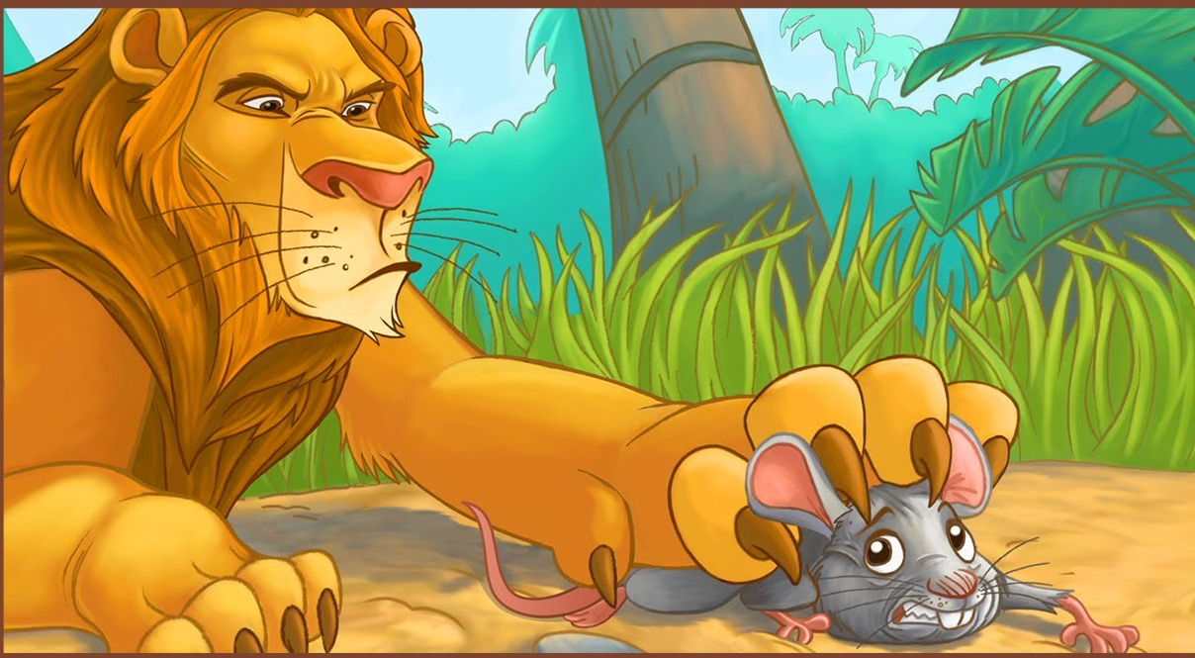
Ire
Meaning
anger
The lion was showing his ire as the mouse awoke him.

Slide 11
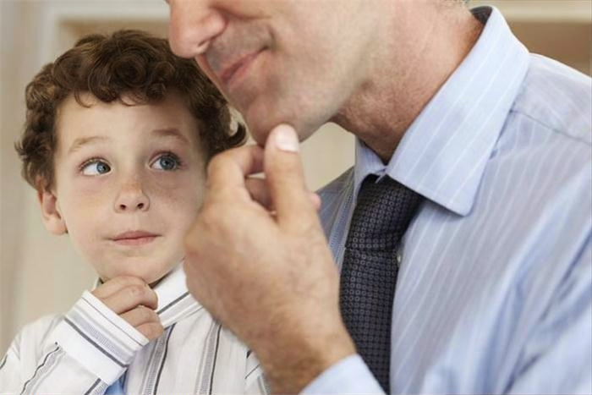
Imitate
Meaning
the action of using someone or something as a model
The boy is imitating the man.

Slide 12
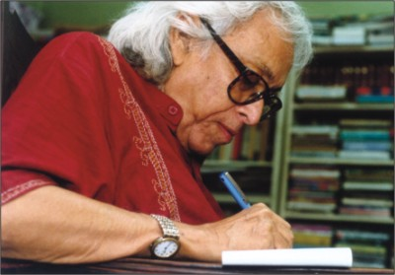
compose
write or create (a work of art, especially music or poetry).
Meaning
The poet Shamsur Rahman is composing poems.

Slide 13
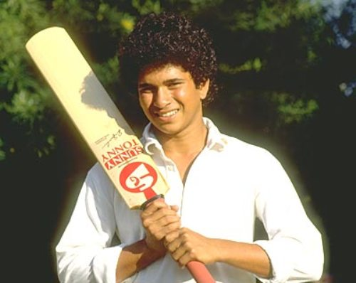
Adolescence
Meaning
teenage years
From his adolescence Shachin Tendulker was a very good player.

Slide 14
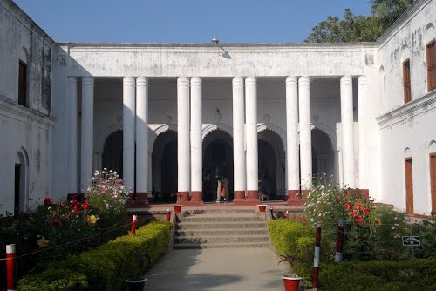
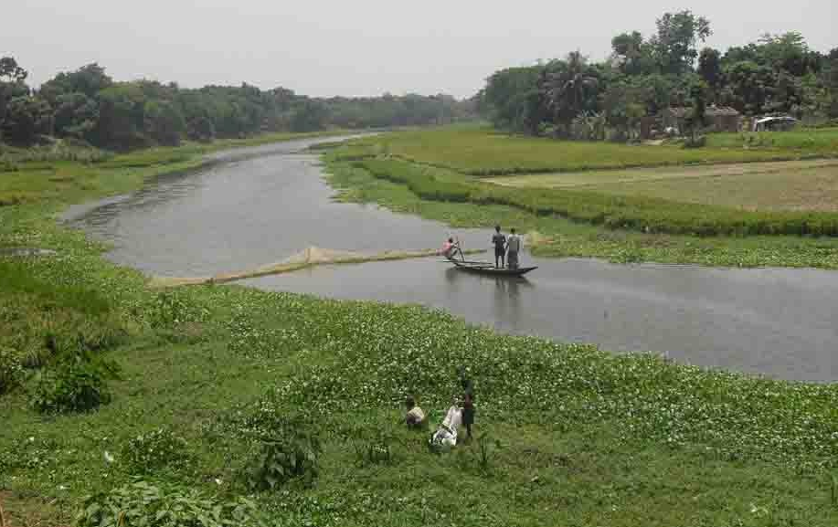
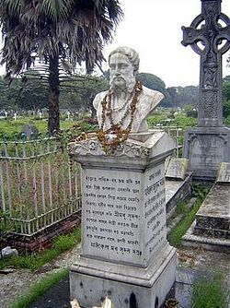
What do you see in the pictures?
Michael Madhusudan Dutt’s residence
Kopotaksha river
His statue
Notes:
The teacher can ask the students to describe the pictures.

Slide 15
Read the text in the book and write the answers of the following questions.
Q 1. How was the reaction of Michael Madhusudan Dutt’s family when he took Christianity?
Q 2. What was his attitude to his root in his adolescence?
Q 3. Why did he compose “Kopotaksha Nad”?

Slide 16
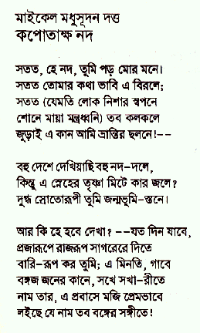
Read some information on Michael. Make questions for the statements.
a) _____________________ ?
1. Michael Madhusudan Dutt composed a sonnet in Bangla named “Kopotaksha Nad”.
Notes:
Answers may vary here.

Slide 17
Read some information on Michael. Make questions for the statements.
b) ____________________________ ?
2. His famous satiric drama is “Buro Shaliker Ghare Row”.
Notes:
Answers may vary here.

Slide 18
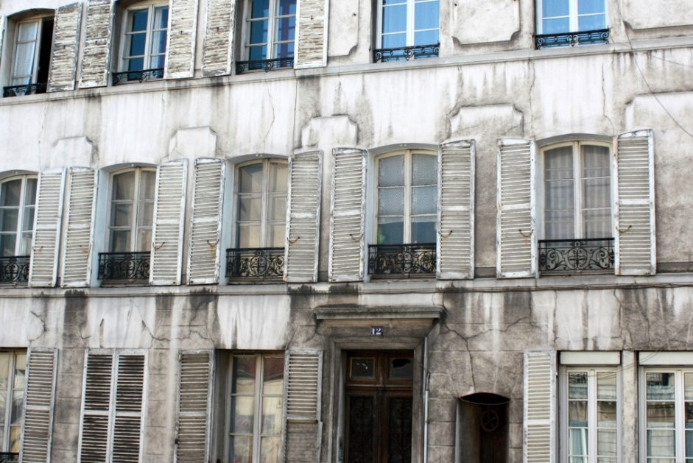
Read some information on Michael. Make questions for the statements.
c) ____________ ?
3. He lived at 12 Rue Des Chantiers, 78000 Versailles, France.
d) ___________________________ ?
3. His days in Europe were not good.
Notes:
Answers may vary here.

Slide 19
Pair work
Go to the text book section C. Make questions for the statements given there.

Slide 20
Home work
How the story of Michael is related to the unit theme Roots.

Slide 21
Acknowledgement
MoE, DSHE, NCTB & A2I respective of officials
And the editors panel: Ranjit Poddar, Associate Professor (English) TTC, Dhaka, Md. Jahangir Hasan (English), Assistant Professor TTC, Rangpur and Urmila Khaled Assistant Professor (English) TTC, Dhaka.
Their direction, valuable suggestions and intensive supervision have enriched the model contents.

Slide 22
Thank You All

